Slide 1
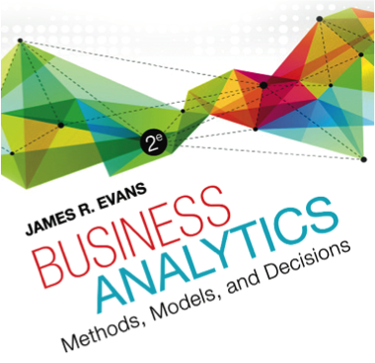
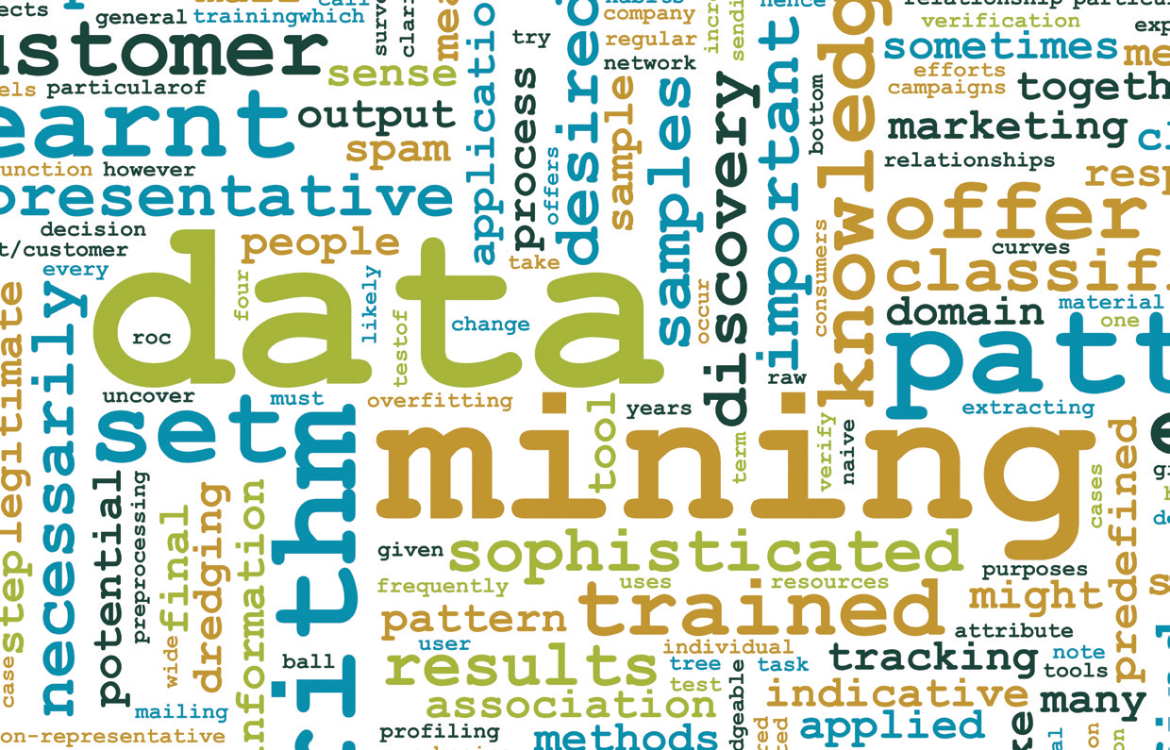
Chapter 10 Introduction to Data Mining

Slide 2
Data Mining
Data mining is focused on better understanding of characteristics and patterns among variables in large databases using a variety of statistical and analytical tools.
It is used to identify relationships among variables in large data sets and understand hidden patterns that they may contain.
XLMiner software implement many basic data mining procedures in a spreadsheet environment.

Slide 3
The Scope of Data Mining
Data Exploration and Reduction
identifying groups in which elements are in some way similar
Classification
analyzing data to predict how to classify a new data element
Association
analyzing databases to identify natural associations among variables and create rules for target marketing or buying recommendations
Cause-and-effect Modeling
developing analytic models to describe relationships between metrics that drive business performance

Slide 4
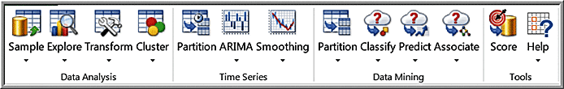
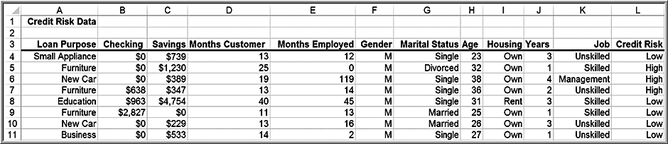
Data Exploration in XLMiner
XLMiner ribbon
XLMiner can sample from an Excel worksheet

Slide 5
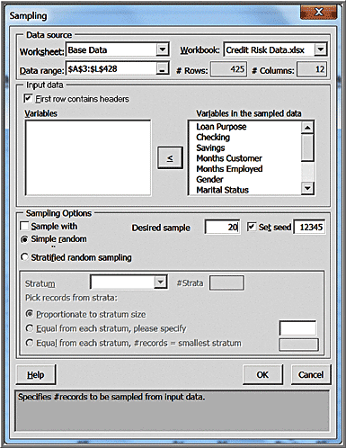
Example 10.1: Using XLMiner to Sample from a Worksheet
Click inside the database
XLMiner > Data Analysis > Sample > Sample from Worksheet
Select variables and move to right pane
Choose sampling options

Slide 6
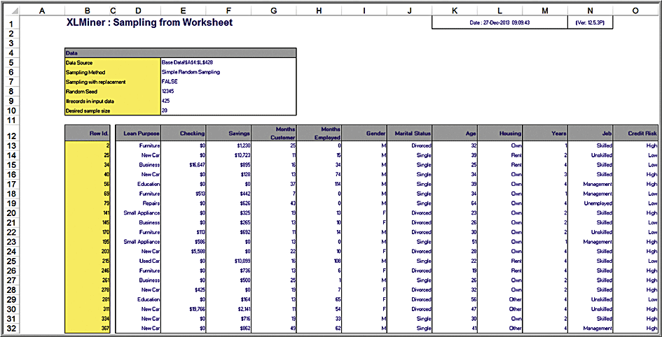
Example 10.1 Continued
Results

Slide 7
Data Visualization
XLMiner has the capability to produce boxplots, parallel coordinate charts, scatterplot matrix charts, and variable charts.
These are found from the Explore button in the Data Analysis group.

Slide 8
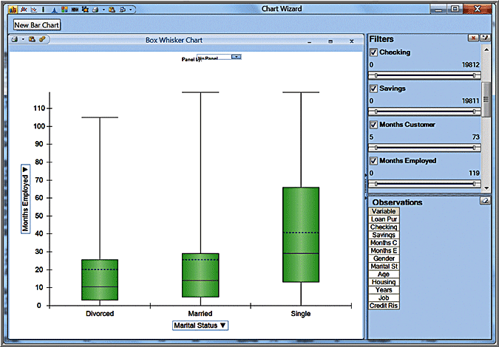
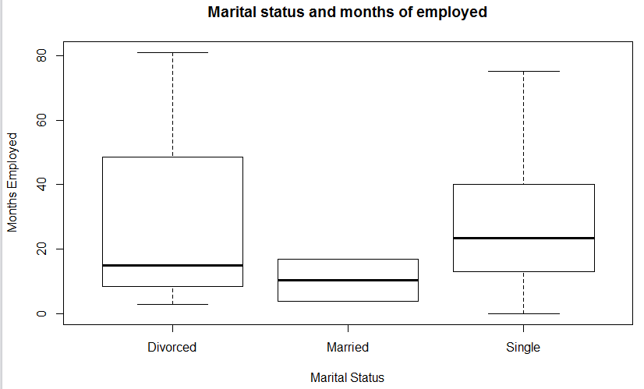
Example 10.2: A Boxplot for Credit Risk Data
XLMiner >Data Analysis > Explore > Chart Wizard > Boxplot
In the second dialog, choose Months Employed as the variable to plot on the vertical axis.
In the next dialog, choose Marital Status as the variable to plot on the horizontal axis.
Click Finish
credit_risk=read.csv(“~/Credit_Risk_Data.csv")
credit_sampled = credit_risk[sample(nrow(credit_risk), 20),] # Getting 20 samples
boxplot(Months.Employed~Marital.Status,data= credit_sampled, main="Marital status and months of employed",xlab="Marital Status", ylab="Months Employed")

Slide 9
Parallel Coordinates Chart
A parallel coordinates chart consists of a set of vertical axes, one for each variable selected. For each observation, a line is drawn connecting the vertical axes. The point at which the line crosses an axis represents the value for that variable.
A parallel coordinates chart creates a “multivariate profile,” and help an analyst to explore the data and draw basic conclusions.

Slide 10
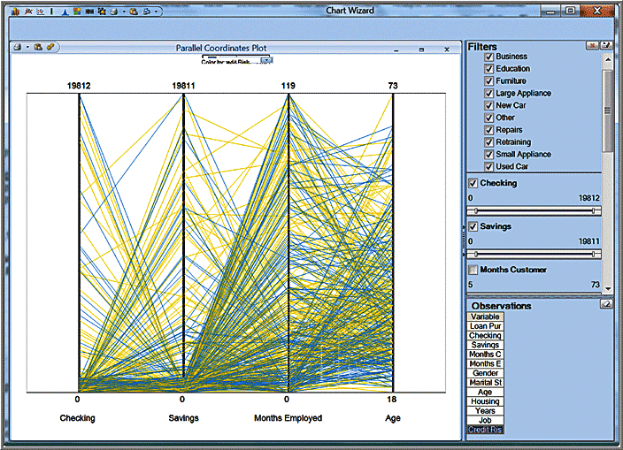
Example 10.3: A Parallel Coordinates Chart for Credit Risk Data
XLMiner > Data Analysis > Explore > Chart Wizard > Parallel Coordinates
In the second dialog, choose Checking, Savings, Months Employed, and Age as the variables to include.
Yellow = low credit risk; blue = high
In R: parcoord(cardeaths, col=rainbow(length(cardeaths[,1])), var.label=TRUE)

Slide 11
Scatterplot Matrix
A scatterplot matrix combines several scatter charts into one panel, allowing the user to visualize pairwise relationships between variables.

Slide 12
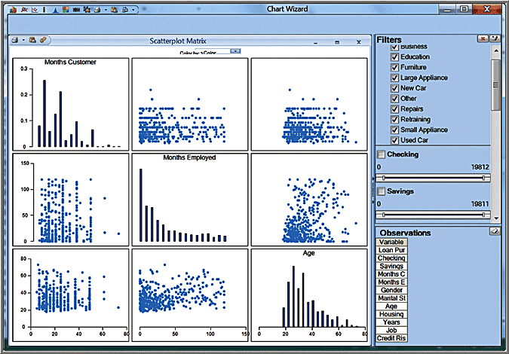
Example 10.4: A Scatterplot Matrix for Credit Risk Data
XLMiner > Data Analysis > Explore > Chart Wizard > Scatterplot Matrix
In the next dialog, check the boxes for Months Customer, Months Employed, and Age and click Finish.

Slide 13
Variable Plot
A variable plot plots a matrix of histograms for the variables selected.

Slide 14
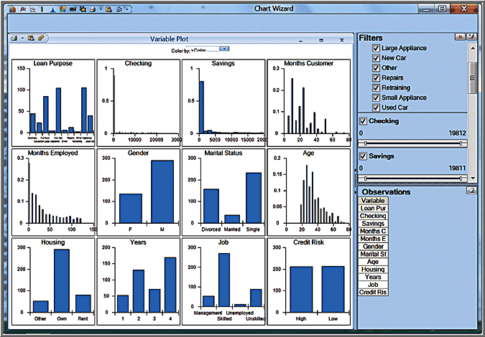
Example 10.5: A Variable Plot of Credit Risk Data
XLMiner > Data Analysis > Explore > Chart Wizard > Variable Plot
In the next dialog, check the boxes for the variables you wish to include and click Finish.

Slide 15
Dirty Data
Real data sets that have missing values or errors. Such data sets are called “dirty” and need to be “cleaned” prior to analyzing them.
Approaches for handling missing data.
Eliminate the records that contain missing data
Estimate reasonable values for missing observations, such as the mean or median value
Use a data mining procedure to deal with them. XLMiner has the capability to deal with missing data in the Transform menu in the Data Analysis group.
Try to understand whether missing data are simply random events or if there is a logical reason. Eliminating sample data indiscriminately could result in misleading information and conclusions about the data.

Slide 16
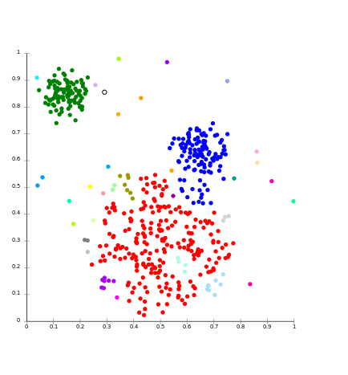
Cluster Analysis
Cluster analysis, also called data segmentation, is a collection of techniques that seek to group or segment a collection of objects (observations or records) into subsets or clusters, such that those within each cluster are more closely related to one another than objects assigned to different clusters.
The objects within clusters should exhibit a high amount of similarity, whereas those in different clusters will be dissimilar.

Slide 17
Cluster Analysis Methods
In hierarchical clustering, the data are not partitioned into a particular cluster in a single step. Instead, a series of partitions takes place, which may run from a single cluster containing all objects to n clusters, each containing a single object.
Agglomerative clustering methods proceed by series of fusions of the n objects into groups.
Divisive clustering methods separate n objects successively into finer groupings.
Hierarchical clustering may be represented by a two-dimensional diagram known as a dendrogram, which illustrates the fusions or divisions made at each successive stage of analysis.

Slide 18
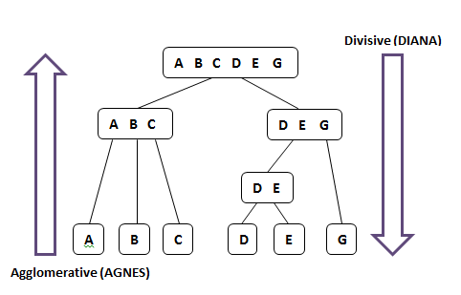
Agglomerative vs. Divisive Clustering

Slide 19
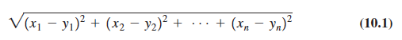
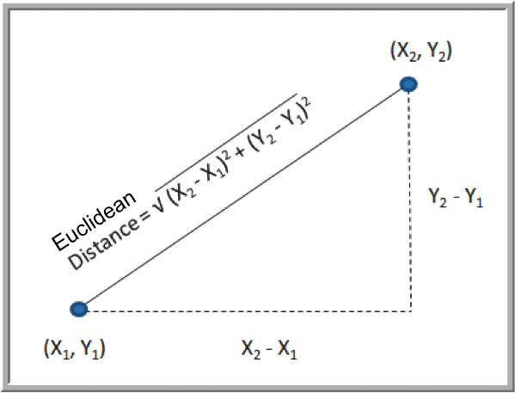
Distance Measures
Euclidean distance is the straight-line distance between two points
The Euclidean distance measure between two points (x₁, x₂, . . . , x_{n}) and (y₁, y₂, . . . , y_{n}) is

Slide 20
Agglomerative Clustering Methods
Single linkage clustering (nearest-neighbor)
The distance between groups is defined as the distance between the closest pair of objects, where only pairs consisting of one object from each group are considered.
At each stage, the closest 2 clusters are merged
Complete linkage clustering
The distance between groups is the distance between the most distant pair of objects, one from each group
Average linkage clustering
Uses the mean values for each variable to compute distance between clusters
Ward’s hierarchical clustering
Uses a sum of squares criterion

Slide 21
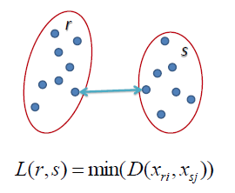
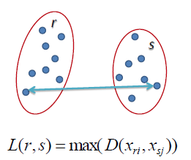
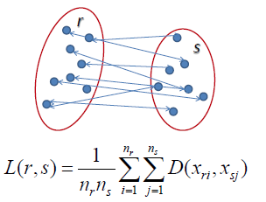
Agglomerative Clustering Methods
Average Linkage: The distance between clusters “r” and “s” to the left is equal to the average length each arrow between connecting the points of one cluster to the other.
Single Linkage: The distance between clusters “r” and “s” to the left is equal to the length of the arrow between their two closest points.
Complete Linkage: The distance between clusters “r” and “s” to the left is equal to the length of the arrow between their two furthest points.

Slide 22
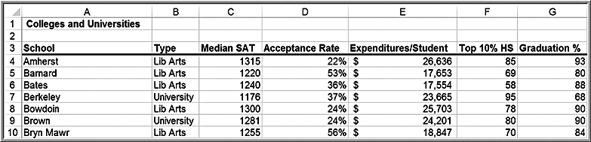
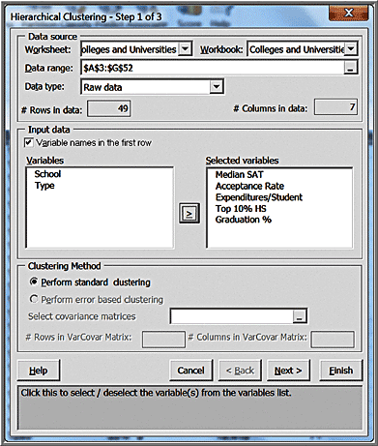
Example 10.6: Clustering Colleges and Universities Data
Cluster the institutions using the five numeric columns in the data set.
XLMiner > Data Analysis > Cluster < Hierarchical Clustering

Slide 23
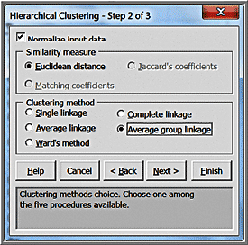
Example 10.6 Continued
Second dialog
Check the box Normalize input data to ensure that the distance measure accords equal weight to each variable

Slide 24
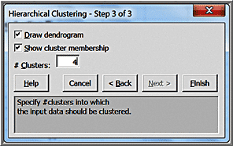
Example 10.6 Continued
Step 3
Select the number of clusters

Slide 25
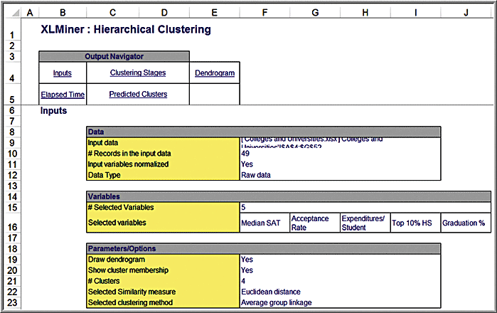
Example 10.6 Continued
Results

Slide 26
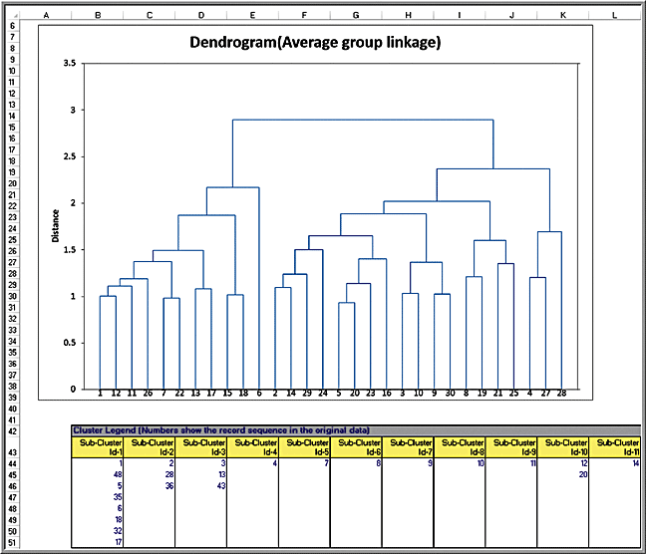
Example 10.6 Continued
Dendogram
A horizontal line shows the cluster partitions

Slide 27
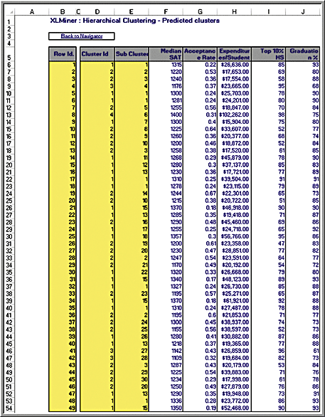
Example 10.6 Continued
Predicted clusters
shows the assignment of observations to the number of clusters we specified in the input dialog, (in this case four)
Cluster # Colleges
1 23
2 22
3 3
4 1

Slide 28
Classification
Classification methods seek to classify a categorical outcome into one of two or more categories based on various data attributes.
For each record in a database, we have a categorical variable of interest and a number of additional predictor variables.
For a given set of predictor variables, we would like to assign the best value of the categorical variable.

Slide 29
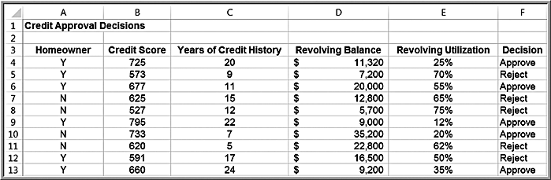
Credit Approval Decisions Data
Categorical variable of interest: Decision (whether to approve – coded as 1 – or reject – coded as 0 – a credit application)
Predictor variables: shown in columns A-E (note that homeowner is also coded numerically)

Slide 30
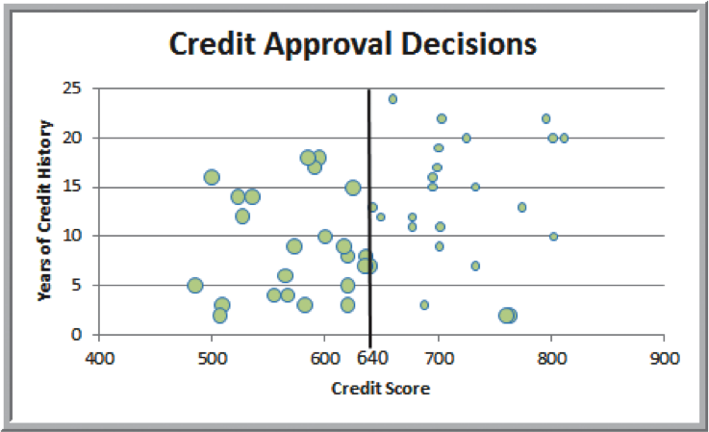
Example 10.7: Classifying Credit-Approval Decisions Intuitively
Large bubbles correspond to rejected applications
When the credit score is > 640, most applications were approved
Classification rule: Reject if credit score ≤ 640
2 misclassifications
out of 50 = 4%

Slide 31
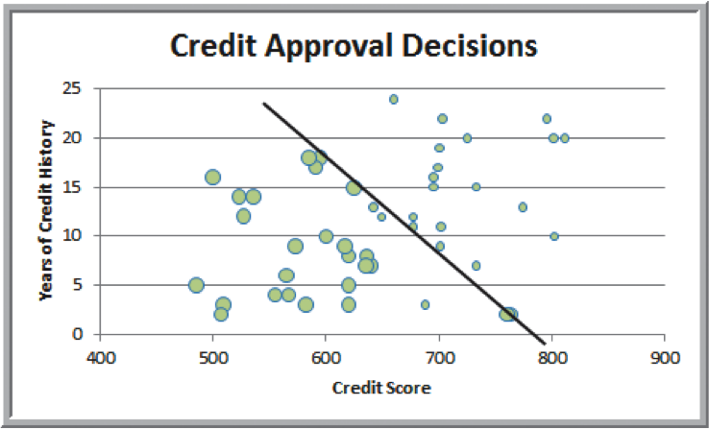
Example 10.7 Continued
Alternate classification rule using visualization
Reject if years + 0.095(credit score) ≤ 74.66
3 misclassifications out of 50 = 6%

Slide 32
Measuring Classification Performance
Find the probability of making a misclassification error and summarize the results in a classification matrix, which shows the number of cases that were classified either correctly or incorrectly.

Slide 33
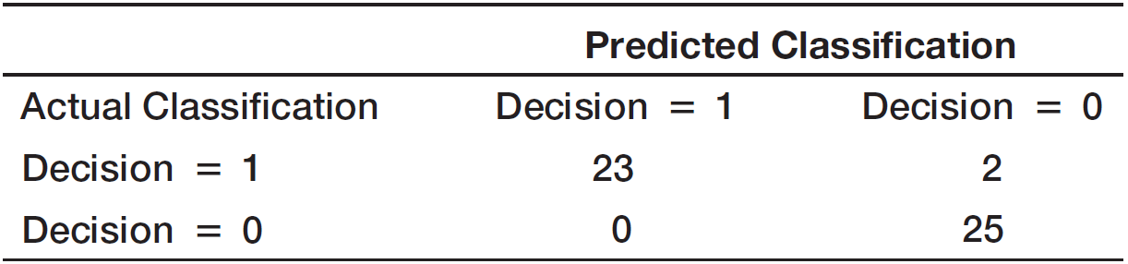
Example 10.8: Classification matrix for Credit-Approval Classification Rules
Off-diagonal elements are the misclassifications
Probability of a misclassification = 2/50 = 0.04

Slide 34
Using Training and Validation Data
Data mining projects typically involve large volumes of data.
The data can be partitioned into:
training data set – has known outcomes and is used to “teach” the data-mining algorithm
validation data set – used to fine-tune a model
test data set – tests the accuracy of the model
In XLMiner, partitioning can be random or user-specified.

Slide 35
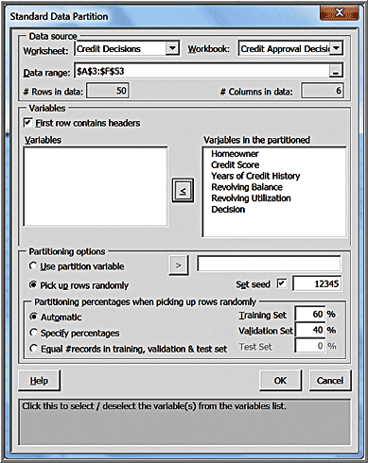
Example 10.9: Partitioning Data Sets in XLMiner
Modified Credit Approval Decisions data
XLMiner > Partition Data > Standard Partition
Select the variables
Choose partitioning options and percentages

Slide 36
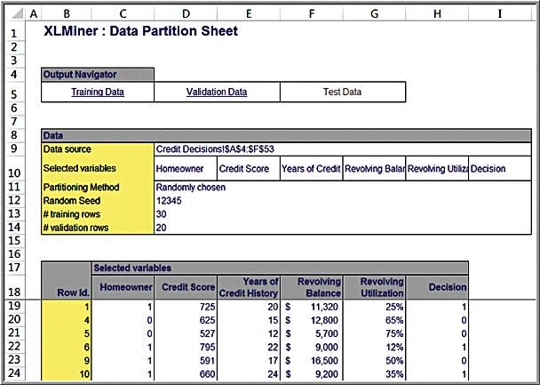
Example 10.9 Continued
Results

Slide 37
Classifying New Data
After a classification scheme is chosen and the best model is developed based on existing data, we use the predictor variables as inputs to the model to predict the output.

Slide 38
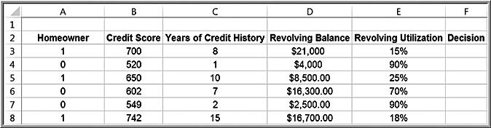
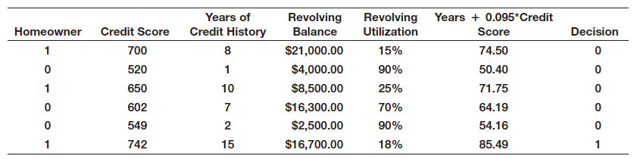
Example 10.9: Classifying New Data for Credit Decisions Using Credit Scores and Years of Credit History
Classify new data using the prior rules developed
Using the second rule, if years + 0.095 × credit score ≤ 74.66,
then only the last record would be approved for credit

Slide 39
Classification Techniques
k-Nearest Neighbors (k-NN) Algorithm
Finds records in a database that have similar numerical values of a set of predictor variables
Discriminant Analysis
Uses predefined classes based on a set of linear discriminant functions of the predictor variables
Logistic Regression
Estimates the probability of belonging to a category using a regression on the predictor variables

Slide 40
k-Nearest Neighbors (k-NN)
Measure the Euclidean distance between records in the training data set.
The nearest neighbor to a record in the training data set is the one that that has the smallest distance from it.
If k = 1, then the 1-NN rule classifies a record in the same category as its nearest neighbor.
k-NN rule finds the k-Nearest Neighbors in the training data set to each record we want to classify and then assigns the classification as the classification of majority of the k nearest neighbors
Typically, various values of k are used and then results inspected to determine which is best.

Slide 41
KNN Example
m
m
f
m
f
f
m
m
u
f
m
m
f
f
f
m
f

Slide 42
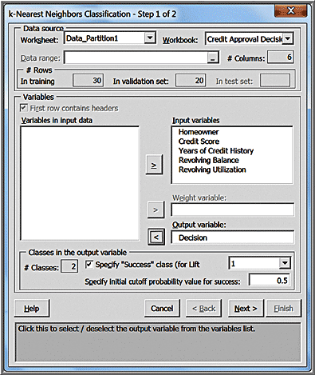
Example 10.10: Classifying Credit Decisions Using the k-NN Algorithm
Partition the data into training and validation sets.
XLMiner > Classify < k-Nearest Neighbors

Slide 43
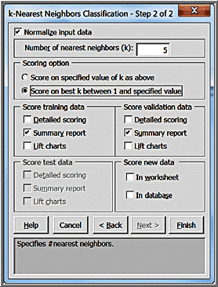
Example 10.10 Continued
Step 2
Check the box Normalize input data
Enter the value for k
Choose scoring option

Slide 44
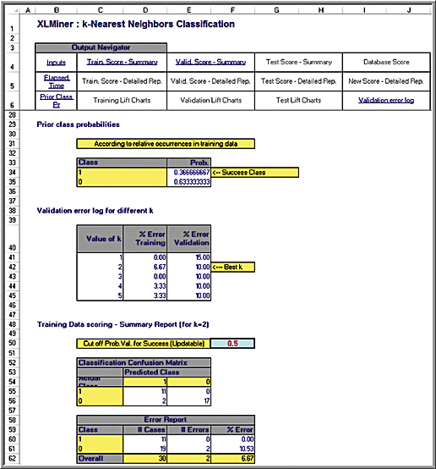
Example 10.10 Continued
Results

Slide 45
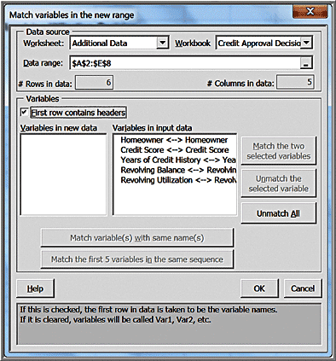
Example 10.11 Classifying New Data using k-NN
Partition the data
In Step 2 of k-NN, normalize the input data and set the number of nearest neighbors (k) to 2, the best value.
Click on In worksheet in the Score new data pane of the dialog to open the Match variables in the new range dialog

Slide 46
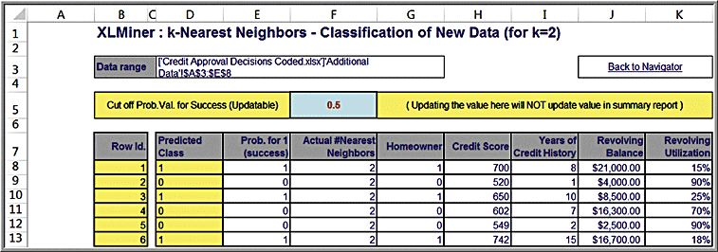
Example 10.11 Continued
Results
Credit for records 1, 3 and 6 are approved

Slide 47
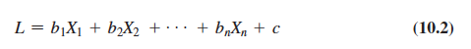
Discriminant Analysis
Discriminant analysis is a technique for classifying a set of observations into predefined classes.
Based on the training data set, the technique constructs a set of linear functions of the predictors, known as discriminant functions:
b_{i} are the discriminant coefficients (weights), X_{i} are the input variables (predictors), c is a constant (intercept)
For k categories, k discriminant functions are constructed. For a new observation, each of the k discriminant functions is evaluated, and the observation is assigned to class i if the i^{th} discriminant function has the highest value.

Slide 48
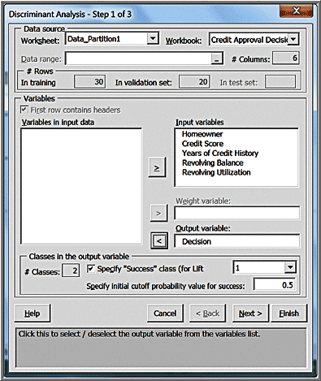
Example 10.12: Classifying Credit Decisions Using Discriminant Analysis
XLMiner > Classify > Discriminant Analysis

Slide 49
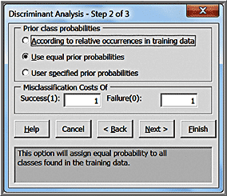
Example 10.12 Continued
Step 2
Select options for prior assumptions about how frequently the different classes occur.

Slide 50
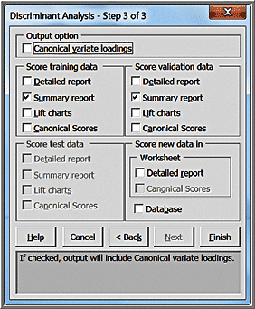
Example 10.12 Continued
Step 3

Slide 51
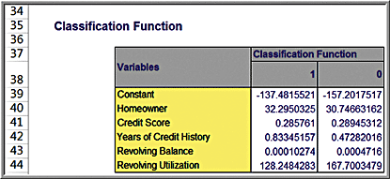
Example 10.12 Continued
Results
Approve the application: L(1) = -137.48 + 32.295 × homeowner + 0.286 × credit score + 0.833 × years of credit history + 0.00010274 × revolving balance + 128.248 × revolving utilization
Reject the application: L(0) = -157.2 + 30.747 3 homeowner = 0.289 × credit score + 0.473 3 years of credit history + 0.0004716 × revolving balance + 167.7 × revolving utilization
For record 1, L(1) = 152.05; L(0) = 139.8. Assign to category 1

Slide 52
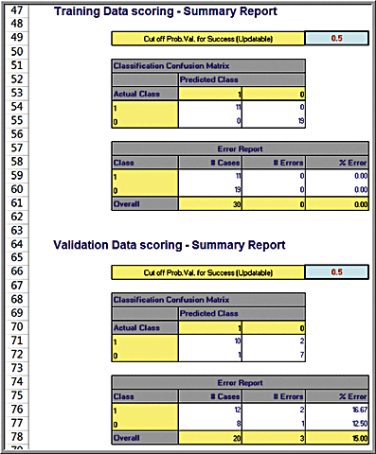
Example 10.12 Continued
Scoring Reports

Slide 53
Example 10.13: Using Discriminant Analysis to Classify New Data
In Step 3, click Detailed report in Score new data in Worksheet pane.

Slide 54
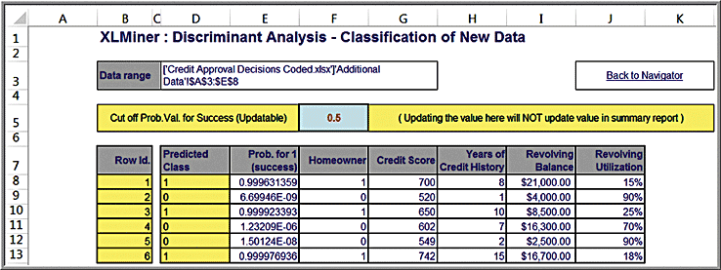
Example 10.13 Continued
Results

Slide 55
Logistic Regression
Logistic regression is variation of linear regression in which the dependent variable is categorical.
Seeks to predict the probability that the output variable will fall into a category based on the values of the independent (predictor) variables. This probability is used to classify an observation into a category.
Generally used when the dependent variable is binary—that is, takes on two values, 0 or 1.

Slide 56
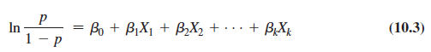
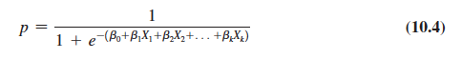
Classification Using Logistic Regression
Estimate the probability p that an observation belongs to category 1, P(Y = 1), and, consequently, the probability 1 - p that it belongs to category 0, P(Y = 0).
Then use a cutoff value, typically 0.5, with which to compare p and classify the observation into one of the two categories.
The dependent variable is called the logit, which is the natural logarithm of p/(1 – p) – called the odds of belonging to category 1.
The form of a logistic regression model is
The logit function can be solved for p:

Slide 57
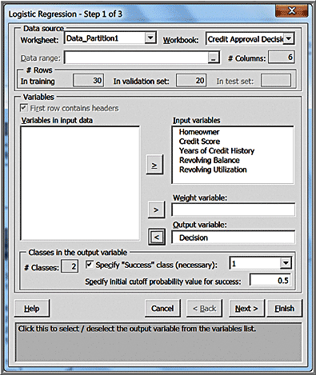
Example 10.14: Classifying Credit Approval Decisions Using Logistic Regression
XLMiner > Classify > Logistic Regression
Partition the data
Specify the data range, the input variables, and the output variable.

Slide 58
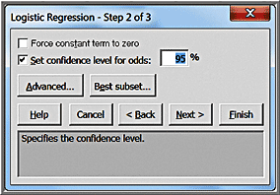
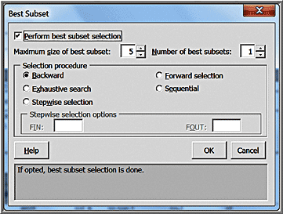
Example 10.14 Continued
Step 2
The Best Subsets button allows XLMiner to evaluate all possible models with subsets of the independent variables.
This is useful in choosing models that eliminate insignificant independent variables.

Slide 59

Example 10.14 Continued
Step 3

Slide 60

Example 10.14 Continued
Results

Slide 61

Example 10.15: Using Logistic Regression to Classify New Data
In Step 3 click on In worksheet in the Score new data pane of the dialog.

Slide 62
Association Rule Mining
Association rule mining, often called affinity analysis, seeks to uncover associations and/or correlation relationships in large data sets
Association rules identify attributes that occur together frequently in a given data set.
Market basket analysis, for example, is used determine groups of items consumers tend to purchase together.
Association rules provide information in the form of if-then (antecedent-consequent) statements.

Slide 63

Example 10.16: Custom Computer Configuration
PC Purchase Data
We might want to know which components are often ordered together.

Slide 64

Measuring Strength of Association
Support for the (association) rule is the percentage (or number) of transactions that include all items both antecedent and consequent.
Confidence of the (association) rule is the ratio of the number of transactions that include all items in the consequent as well as the antecedent (namely, the support) to the number of transactions that include all items in the antecedent.
Lift is a ratio of confidence to expected confidence.
Expected confidence is the number of transactions that include the consequent divided by the total number of transactions.
The higher the lift ratio, the stronger the association rule; a value greater than 1.0 is usually a good minimum.

Slide 65
Example 10.17: Measuring Strength of Association
A supermarket database has 100,000 point-of-sale transactions; 2000 include both A and B items; 5000 include C; and 800 include A, B, and C
Association rule: “If A and B are purchased, then C is also purchased.”
Support = 800/100,000 = 0.008
Confidence = 800/2000 = 0.40
Expected confidence = 5000/100,000 = 0.05
Lift = 0.40/0.05 = 8

Slide 66

Example 10.18: Identifying Association Rules for PC Purchase Data
XLMiner > Associate > Association Rules
Input options:
Data in binary matrix format: Choose this option if each column in the data represents a distinct item and the data are expressed as 0s and 1s.
Data in item list format: Choose this option if each row of data consists of item codes or names that are present in that transaction.
Specify minimum support and confidence parameters

Slide 67

Example 10.18 Continued
Results
Rule 1 states that if a customer purchased a 15-inch screen with an Intel Core i7 processor, then a 750 GB hard drive was also purchased.

Slide 68

Example 10.18 Continued
Display of Rule #1
Confidence (Conf.%) means that of the people who bought a 15-inch screen and a core i7 processor, all (100%) bought 750 GB hard drives as well.
Support (a) indicates that 5 customers bought a 15-inch screen and a core i7 processor.
Support (c) indicates the number of transactions involving the purchase of options, total.
Support (a U c) is the number of transactions in which a 15-inch screen, Intel Core i7, and 750 GB hard drive were ordered.
Lift Ratio indicates how much more likely we are to encounter a 750 GB transaction if we consider just those transactions where a 15-inch screen and Intel Core i7 are purchased, as compared to the entire population of transactions.

Slide 69
Cause-and-Effect Modeling
Correlation analysis can help us develop cause-and-effect models that relate lagging and leading measures.
Lagging measures tell us what has happened and are often external business results such as profit, market share, or customer satisfaction.
Leading measures predict what will happen and are usually internal metrics such as employee satisfaction, productivity, and turnover.

Slide 70


Example 10.19: Using Correlation for Cause-and-Effect Modeling
Ten Year Survey data
Satisfaction was measured on a 1-5 scale.
Correlation matrix

Slide 71

Example 10.19 Continued
Logical model

